Slide 1
What is cbeta deviation

Slide 2
In protein structure validation, Ramachandran outliers are a strong, but not absolute, indicator that the backbone confirmation of your protein structure deviates from all the high resolution structures known to date, and hence need your attention during the progress of refinement.
If all the phi-psi angles (backbone conformation) all fall into the "allowed/favoured" regions on the Ramachandran plot, your structure model is probably, but not necessarily, esp in the case of low resolution, correct. Hence there are other weaker criteria in protein structure validation, and Cbeta deviation is just one of them. In the light of high resolution structures out there, it turns out that Cbeta also has a favoured range of dihedral angles, suggesting that any misfit between your structure and the "probable" side chain-backbone conformation also deserves your attention during structure refinement.

Slide 3
The alpha carbon (Cα) in organic molecules refers to the first carbon atom that attaches to a functional group
The nomenclature can also be applied to the hydrogen atoms attached to the carbon atoms. A hydrogen atom attached to an alpha carbon atom is called an alpha-hydrogen atom, a hydrogen atom on the beta-carbon atom is a beta hydrogen atom, and so on.
Generally the functional group responsible for the name or type of the molecule is the 'reference' group for purposes of carbon-atom naming.

Slide 4
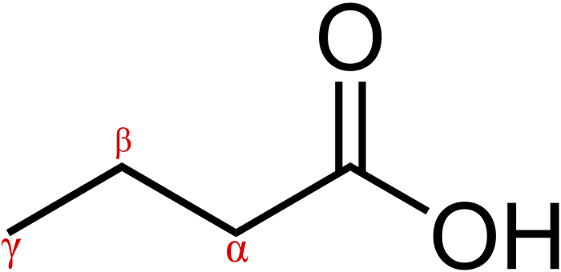
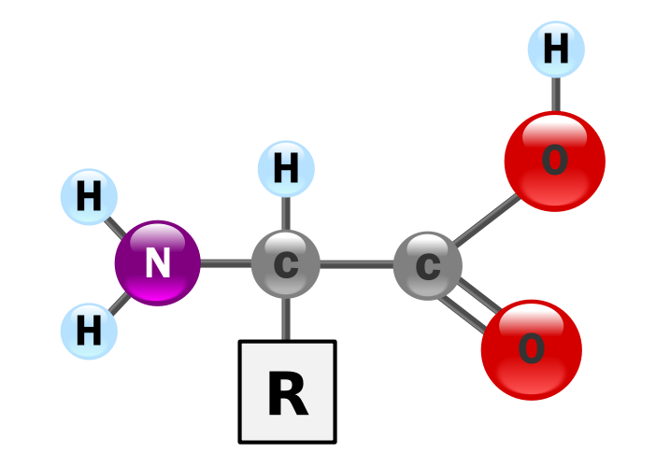
Alpha-carbon (α-carbon) is also a term that applies to proteins and amino acids. It is the backbone carbon before the carbonyl carbon.
The α-carbon is where the different substituents attach to each different amino acid.

Slide 5
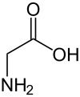
Glycine does not have a α and β-carbon, while every other amino acid does.
The α-carbon of an amino acid is significant in protein folding. When describing a protein, which is a chain of amino acids, one often approximates the location of each amino acid as the location of its α-carbon.

